Slide 1
Chapter 7 : Statistical Intervals Based on a Single Sample

Slide 2
Outline
Basic properties of confidence intervals
Large-sample confidence intervals
Intervals based on a normal population distribution
Confidence intervals for the variance and standard deviation

Slide 3
Population
Sample
Inference
Parameters
Statistics

Slide 4
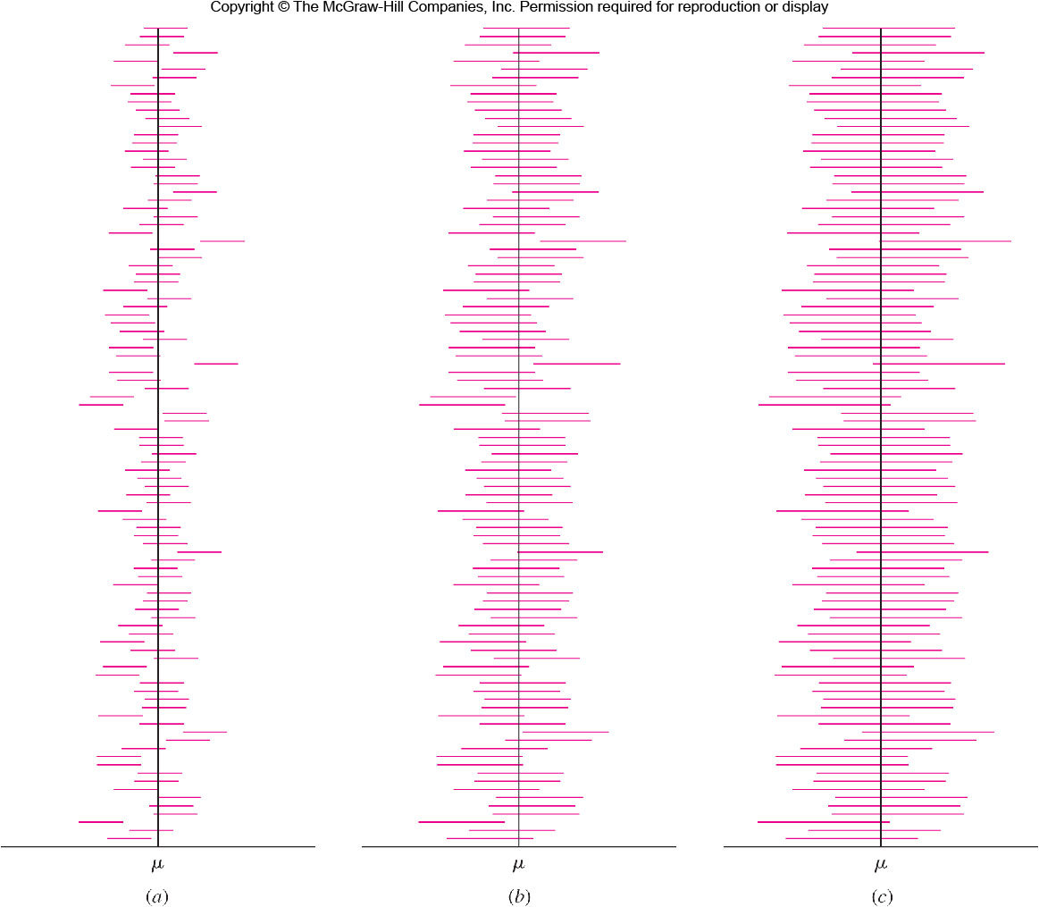

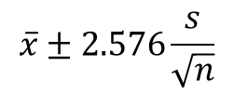
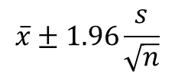
Figure 5.5
$$\overline{x}±1.0\frac{s}{\sqrt{n}}$$
$$\overline{x}±1.96\frac{s}{\sqrt{n}}$$
$$\overline{x}±2.576\frac{s}{\sqrt{n}}$$

Slide 5
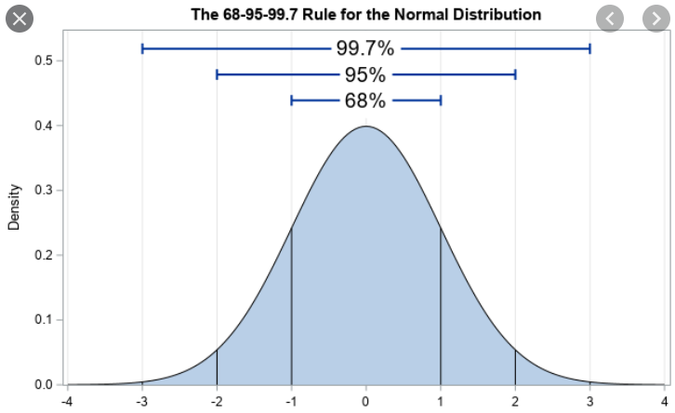
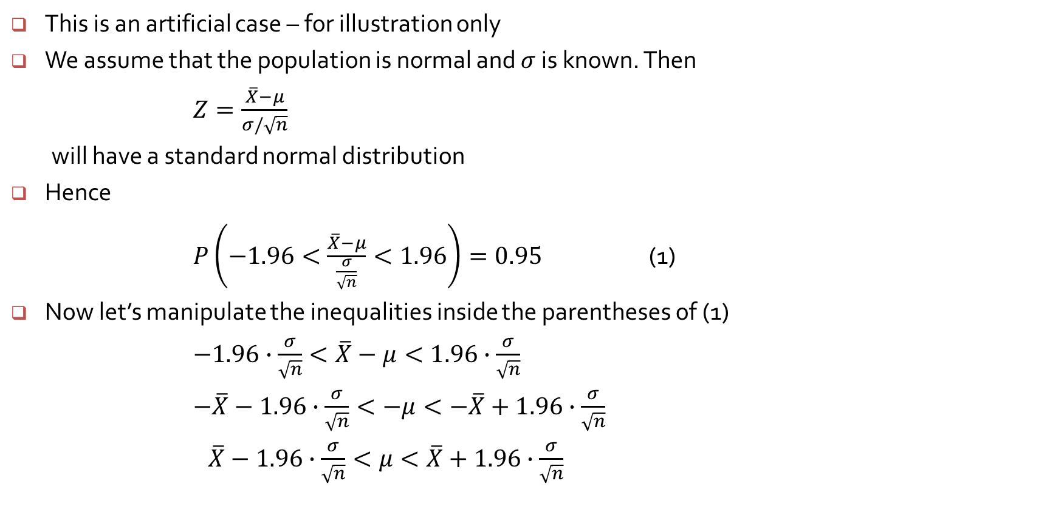
Confidence interval when $σ$ known
This is an artificial case – for illustration only
We assume that the population is normal and $σ$ is known. Then
$Z=\frac{\overline{X}−μ}{σ/\sqrt{n}}$
will have a standard normal distribution
Hence
$P\left(−1.96<\frac{\overline{X}−μ}{\frac{σ}{\sqrt{n}}}<1.96\right)=0.95$ (1)
Now let’s manipulate the inequalities inside the parentheses of (1)
$−1.96∙\frac{σ}{\sqrt{n}}<\overline{X}−μ<1.96∙\frac{σ}{\sqrt{n}}$
$−\overline{X}−1.96∙\frac{σ}{\sqrt{n}}<−μ<−\overline{X}+1.96∙\frac{σ}{\sqrt{n}}$
$\overline{X}−1.96∙\frac{σ}{\sqrt{n}}<μ<\overline{X}+1.96∙\frac{σ}{\sqrt{n}}$

Slide 6
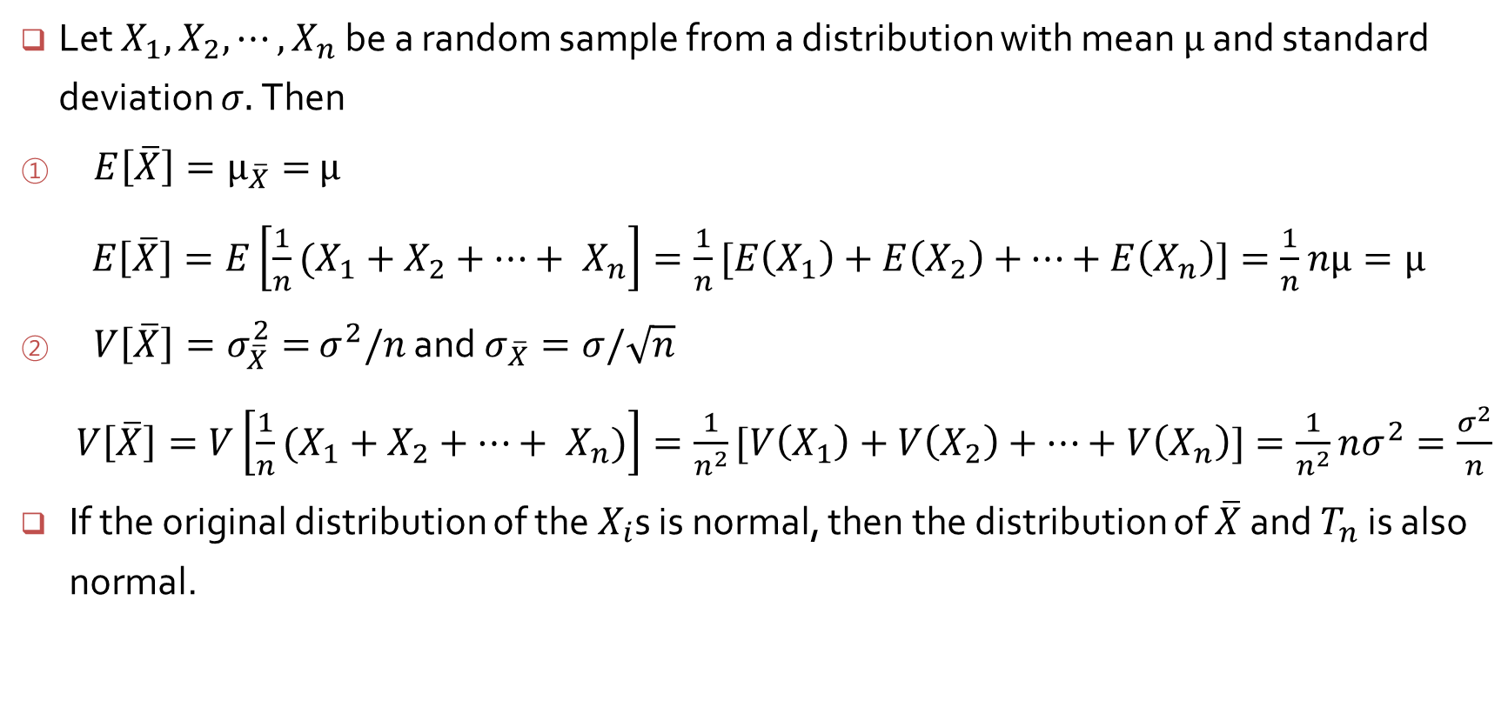
Properties of sample mean and sample sum
Let $X_{1},$ $X_{2},⋯, X_{n}$ be a random sample from a distribution with mean $μ$ and standard deviation $σ.$Then
$E\left[\overline{X}\right]=μ_{\overline{X}}=$ $μ$
$E\left[\overline{X}\right]=E\left[\frac{1}{n}(X_{1}+X_{2}+⋯+ X_{n}\right]=\frac{1}{n}[E\left(X_{1}\right)+E\left(X_{2}\right)+$ $⋯+E\left(X_{n}\right)]=\frac{1}{n}$ $nμ=μ$
$V\left[\overline{X}\right]=σ_{\overline{X}}^{2}=$ $σ^{2}/n$ and $σ_{\overline{X}}=σ/\sqrt{n}$
$V\left[\overline{X}\right]=V\left[\frac{1}{n}(X_{1}+X_{2}+⋯+ X_{n})\right]=\frac{1}{n^{2}}[V\left(X_{1}\right)+V\left(X_{2}\right)+$ $⋯+V\left(X_{n}\right)]=\frac{1}{n^{2}}nσ^{2}=\frac{σ^{2}}{n}$
If the original distribution of the $X_{i}$s is normal, then the distribution of $\overline{X}$ and $T_{n}$ is also normal.

Slide 7

Confidence interval when $σ$ known
This implies that
$P\left(\overline{X}−1.96\frac{σ}{\sqrt{n}}<μ<\overline{X}+1.96\frac{σ}{\sqrt{n}}\right)=0.95$
We construct the 95% confidence interval on $μ$ as
$\overline{x}±1.96\frac{σ}{\sqrt{n}}$

Slide 8
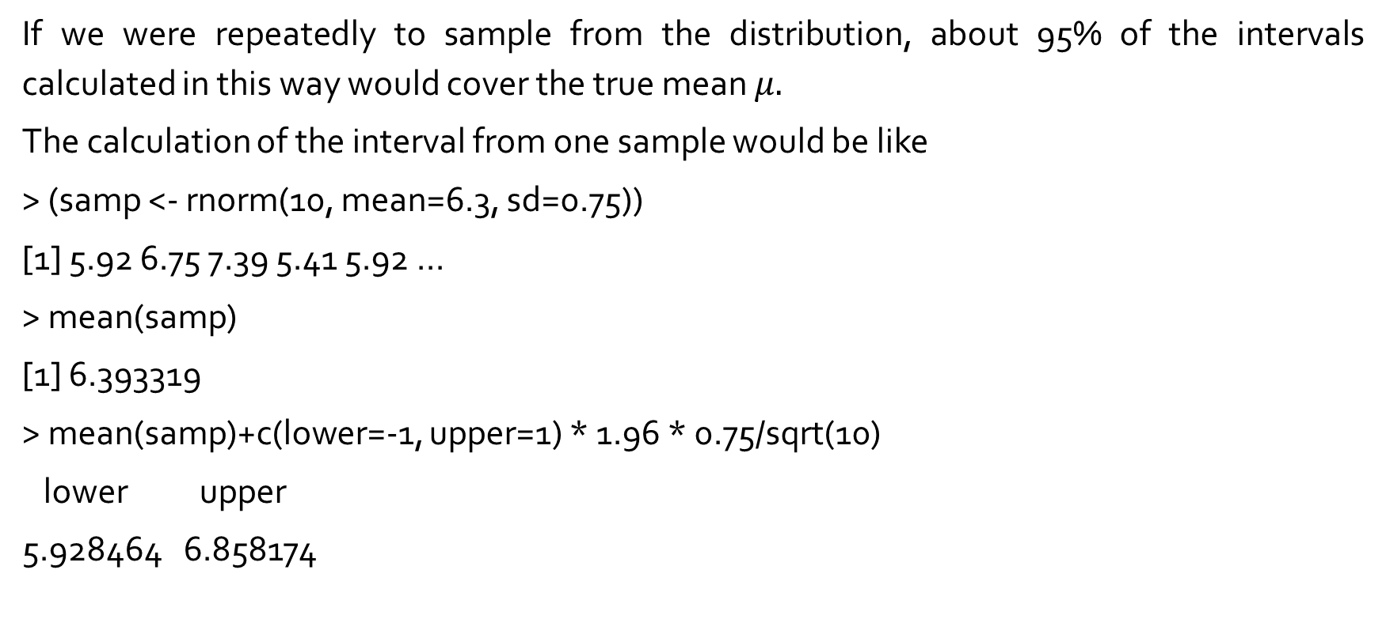
Interpretation
If we were repeatedly to sample from the distribution, about 95% of the intervals calculated in this way would cover the true mean $μ.$
The calculation of the interval from one sample would be like
> (samp <- rnorm(10, mean=6.3, sd=0.75))
[1] 5.92 6.75 7.39 5.41 5.92 ...
> mean(samp)
[1] 6.393319
> mean(samp)+c(lower=-1, upper=1) * 1.96 * 0.75/sqrt(10)
lower upper
5.928464 6.858174

Slide 9
> (samp <- matrix(rnorm(50*10, mean=6.3, sd=0.75), nr=10))[,1:5]
[,1] [,2] [,3] [,4] [,5]
[1,] 6.870958 6.527197 6.899196 5.908721 5.917030
[2,] 4.479679 5.197282 8.139894 7.884092 5.491819
[3,] 5.816830 5.630525 6.060385 7.223066 6.430127
[4,] 4.581629 6.245015 5.778225 5.055725 6.564454
[5,] 7.215877 6.707928 6.590626 5.660643 5.993251
[6,] 6.281721 6.443767 6.730829 6.537824 5.372925
[7,] 5.358579 6.277609 6.782129 6.280670 5.683414
[8,] 7.109161 6.567141 7.609636 6.417673 5.638521
[9,] 5.598220 6.940539 5.635173 5.709908 6.340991
[10,] 7.847204 5.194830 6.520720 6.691987 5.799198
> (lims <- outer(c(lower=-1, upper=1) * 1.96 * 0.75/sqrt(10), colMeans(samp), "+"))[,1:5]
[,1] [,2] [,3] [,4] [,5]
lower 5.651131 5.708328 6.209826 5.872176 5.458318
upper 6.580841 6.638038 7.139536 6.801886 6.388028

Slide 10
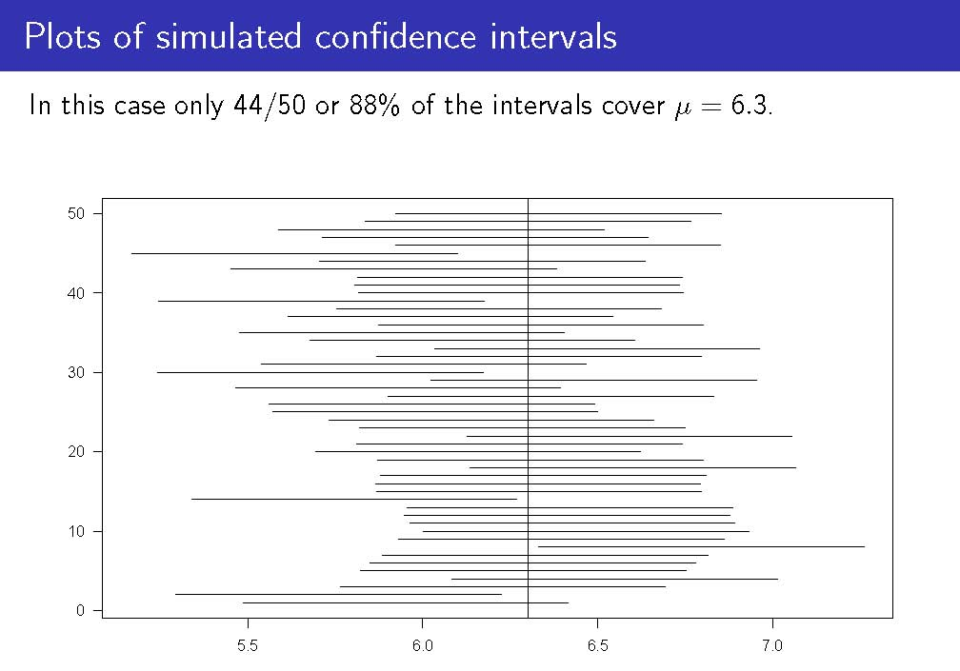

Slide 11
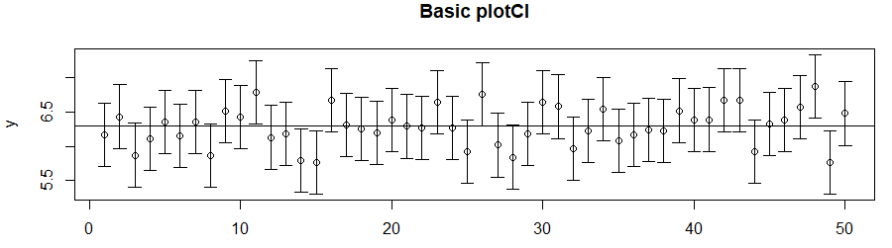
> library(plotrix)
> y <- colMeans(samp)
> err <- 1.96 * 0.75/sqrt(10)
> plotCI(1:50,y,err,main="Basic plotCI")
> abline(h=6.3)

